Slide 1
Building IoT Applications with C#
Chicago C# WEB DEVELOPER’S GROUP
April 25, 2019
Presented BY Ken SamsoN

Slide 2
A little about me…
Profession Job – Build Web Applications for the University of Chicago, Department of Medicine
Working with IoT devices as a hobby.
Mostly worked on Raspberry Pi and Arduino boards
How to find me:
LinkedIn : https://www.linkedin.com/in/kenssamson/
Twitter : https://twitter.com/kenssamson
GitHub : https://github.com/kenssamson

Slide 3
What is IoT?

Slide 4
A Brief History…
In 1982, Students at Carnegie Mellon University invent the ARPANET-connected Coke Machine
In 1999, term “Internet of Things” introduced by Kevin Ashton while working at Proctor & Gamble
In 2008, the Internet has more “things” than people connected
By 2014, the number of devices exceeds the world population
Also in 2014, IoT is the main theme at the CES Conference

Slide 5
What are the Characteristics of IoT Devices
A Unique
Identifier
Wireless
communications
The ability to
sense or
measure
something
Embedded
electronics
+
+
+

Slide 6
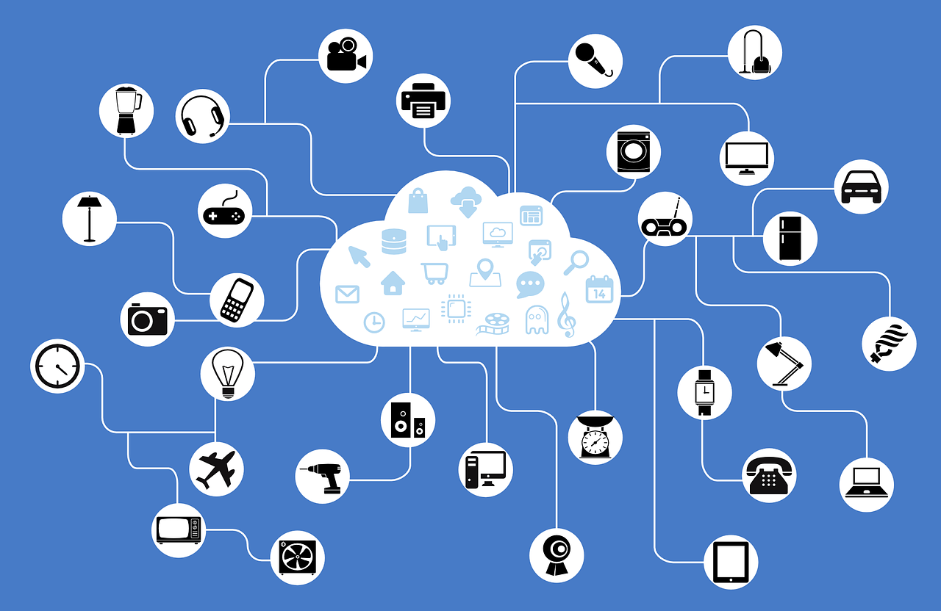
What is IoT?

Slide 7
IoT Development Boards

Slide 8
Early IoT Boards
Built for a Specific Purpose
Built for Professional’s
Required Custom Development Kits
Were relatively expensive

Slide 9
Arduino
First introduced in 2005 to help student learn about electronics and microcontroller programming
Design and Software are Open-Source
Relatively inexpensive compared to other microcontroller platforms with most boards costing less than $50
IDE used to build “sketches” runs on Windows, Macintosh, and Linux
No OS on boards – sketch is downloaded to board
Most boards use an Atmel 8-bit AVR Microcontroller

Slide 10
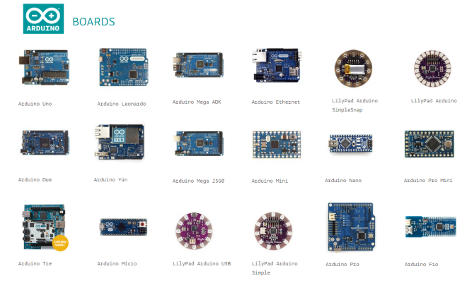
Arduino boards

Slide 11
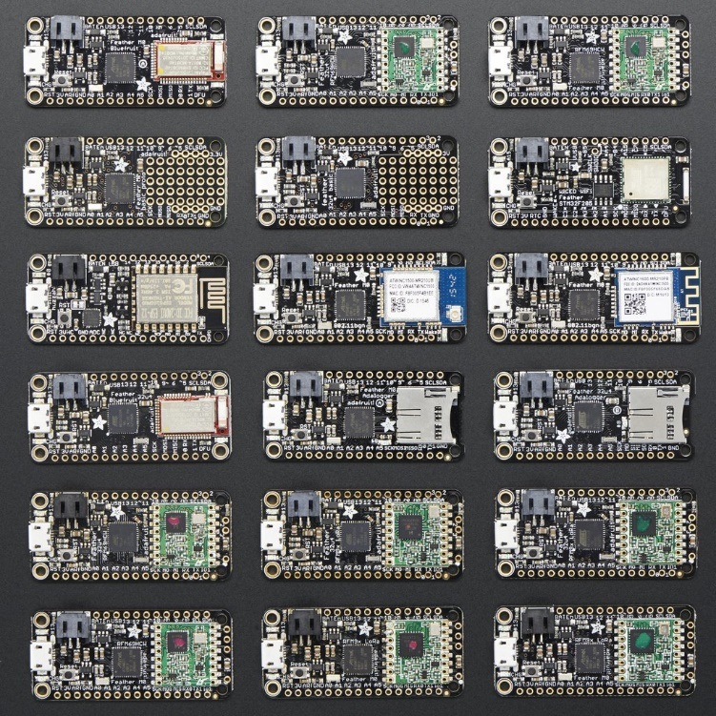
Adafruit FEATHER Boards – ALSO Arduino BOARDS
Same Layout as Arduino Micro/Nano
Same Family of Processors
Same Build Environment

Slide 12
Raspberry Pi
Designed by the Raspberry Pi Foundation, a charitable organization in England whose goal is to increase interest in Computer Science and related disciplines
Boards cost around $25 to $35, initial sales began Feb 2012
Series of small single-board computers that use Broadcom ARM 32bit/64bit microprocessors
Various OS’s work on the Pi – including Window 10 IOT and multiple Linux builds
Default OS, called Raspbian, is based on Debian

Slide 13
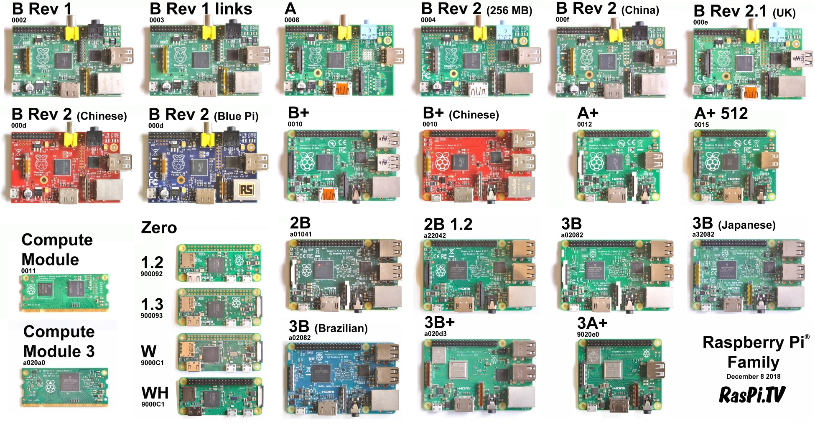
Raspberry PI family of Boards

Slide 14
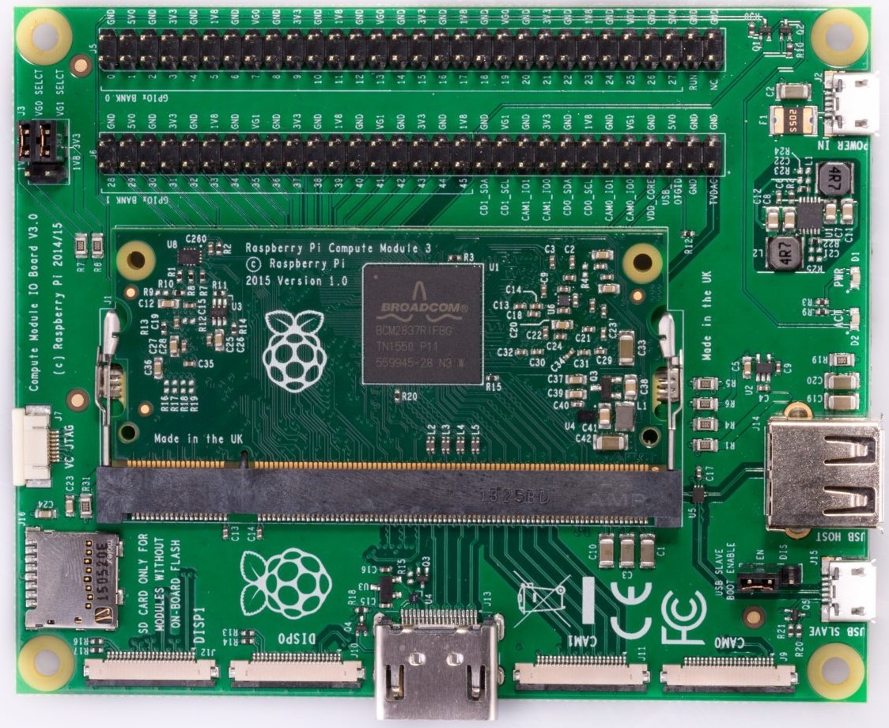
Compute module IO Board

Slide 15
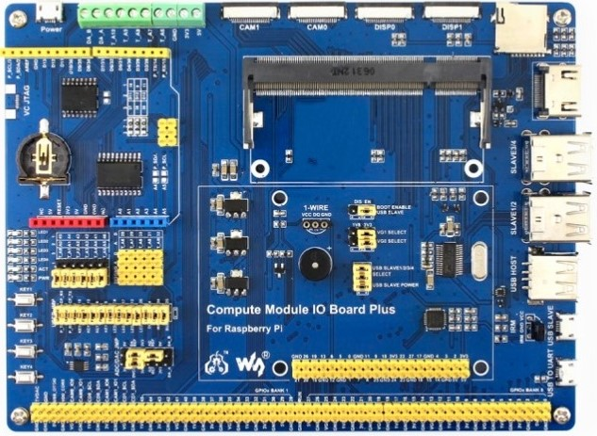
Compute Module IO board Plus

Slide 16
Arduino versus Raspberry PI
Arduino
RasPBerry PI
Use Atmel 8-bit AVR Microcontroller
No OS
Single Application
C/C++
Very Limited C# Support
Use Broadcom 32-bit / 64-bit ARM Microcontroller
Supports Linux, Windows IOT
Multiple Applications
C/C++ and Python
Supports Java, Perl, Ruby, Nodes, C#, and More

Slide 17
Arduino Programming

Slide 18
Arduino Program Structure
Board Bootloader
<Project Name>.ino
void setup() {
// put your setup code here, to run once:
}
void loop() {
// put your main code here, to run repeatedly:
}
Main Program

Slide 19
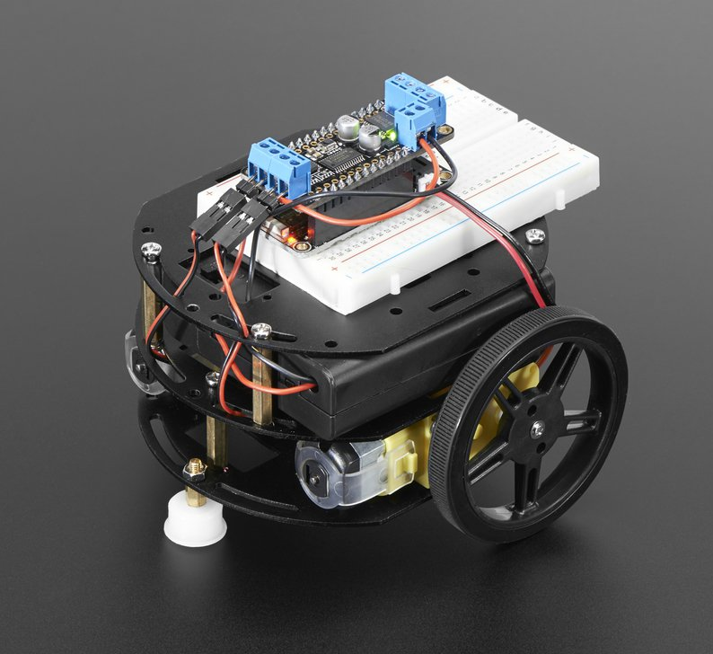
Arduino Sample
Adafruit AdaBox002 – Making Things Move – Feather Bluetooth LE Mini Robot

Slide 20
Raspberry PI Programming

Slide 21
Raspberry PI Programming Basics
Default OS is called Raspbian, it is based on Debian 9 (Stretch) using the 32-bit ARM build.
Basic Understanding of Linux is Useful
Limited Processor, Memory, and Space
1.4 GHz quad-core ARM Cortex-A53 CPU (running in 32bit mode)
1GB or RAM / USB 2.0
Micro SD Card contains all software (backup regularly)
3.3v / 5v limit

Slide 22


Slide 23
Using C# - The Good, The Bad, and The Ugly
Linux ARM v7/v8 support added in .Net Core 2.1 (Pi2, Pi3, CM3)
Pi1 and Pi Zero use an ARMv6 processor, Mono only option for C#
Most Linux code and examples use Mono instead of .Net Core
Compiling on the Device is Painfully Slow (but there’s an easy work around)
Many .Net Core Projects don’t actually support the ARM architecture
Some Code Samples and Projects built for Windows 10 IOT instead
Limited Resources for Third-Party Hardware and/or Peripherals

Slide 24
Mono versus .Net Core
Mono project
.Net core
Latest supported version is 4.6.2
Released 11/08/2016
.NET Standard 1.6
.NET Framework 4.6.2 (C# 6)
Partial Support of MVC4/MVC5
ASP.NET, Console
WinForms (using GTK)
Supports Latest Version (2.2.4)
Released 04/09/2019
.Net Standard 2.0
.Net Core 2.2 (C# 7)
Full support of ASP.NET Core
ASP.NET, Console
Desktop Apps (using GTK)

Slide 25
Windows 10 IOT
Only one Front End Application (built using WPF) runs at a time
Multiple Back End Applications can run simultaneous
Limited Hardware Support
Doesn’t Support Pi Camera Module
Doesn’t Support Pi 3B+
Doesn’t Support Onboard Bluetooth
Designed to Connect to Azure IOT Hub
Build Once, Deploy Multiple
Creates Abstraction Layer between Hardware and Application

Slide 26
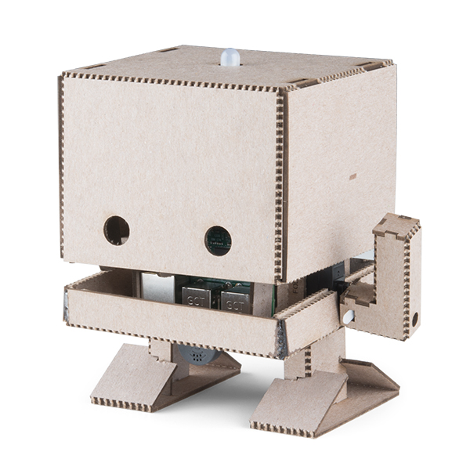
Raspberry PI Demo 1
IBM TJ Bot

Slide 27
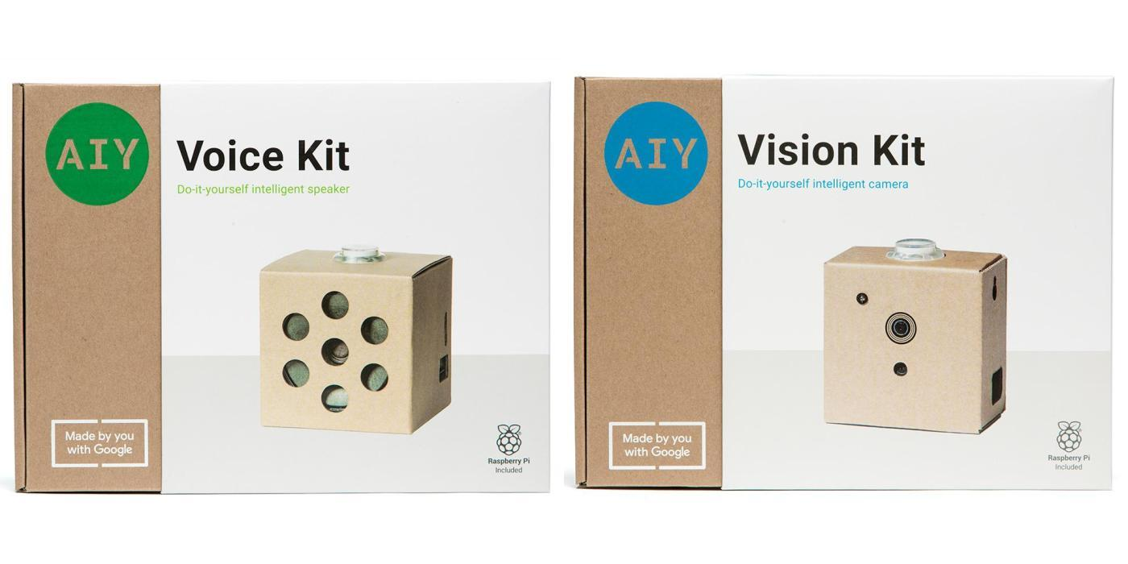
Raspberry PI DEMO 2
Google AIY Projects – Voice and Vision

Slide 28
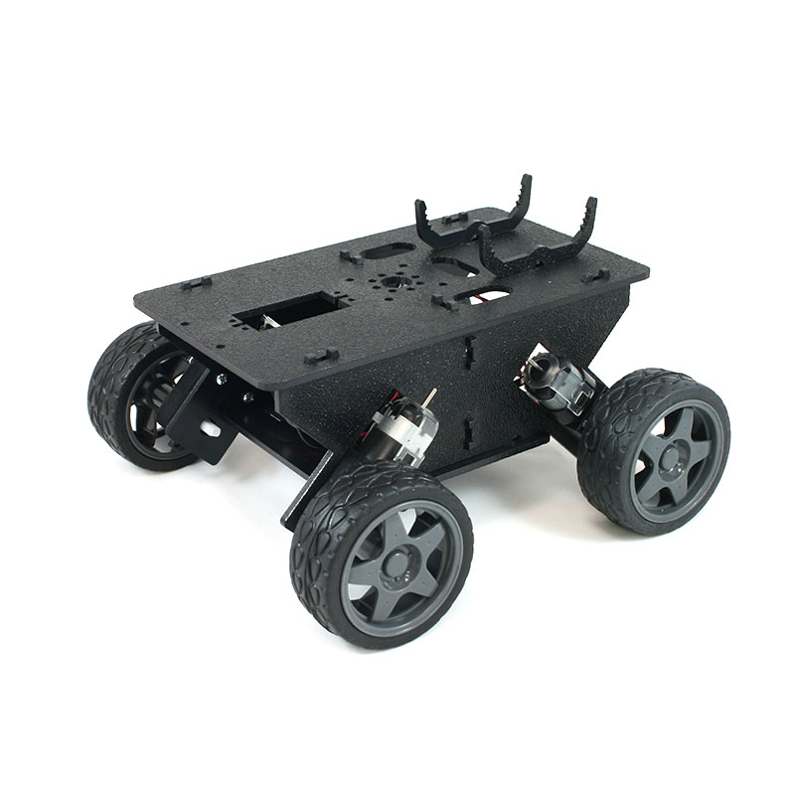
RASPBERRY PI DEMO 3
Homemade Robot

Slide 29
Future So Bright, I Got To Wear Shades
.NET Core 3.0
C# 8.0
Iot Support - System.Device.Gpio & Iot.Device.Bindings
Raspberry PI 4
Not Coming in 2019 and Nothing Confirmed
More Processing Power, More RAM, Faster Network and I/O
Current boards have max 1 GB RAM and USB 2.0
May use USB Type-C connector for power
Same Initial Price as current boards - $35
Same General Size
Pi Zero has it’s own Development Schedule

Slide 30
Things To Keep In Mind
Raspberry PI and Arduino boards are designed for learning and prototyping. They are great for small personal projects. They not designed for Commercial Production Environments
The .Net Environment is not directly supported on most commercial hardware, applications will probably need to be converted to C/C++ or Python
Follow the basic rule – K.I.S.S. – Keep It Simple Stupid
Have Fun and Save Room for Pie

Slide 31
Useful Links
Raspberry Pi - https://www.raspberrypi.org/
Arduino - https://www.arduino.cc/
Google AIY Projects - https://aiyprojects.withgoogle.com/
IBM TJBot - https://ibmtjbot.github.io/
Sample Source Code & Resources - https://github.com/kenssamson/meetup-cs-web-apr19

Slide 32
Any Questions?

